Slide 1




Slide 2
Objectives
Describe the differences between requirements activities and design activities
Explain the purpose of design and the difference between architectural and detailed design activities
Describe each design discipline activity
Object-Oriented Analysis and Design with the Unified Process

Slide 3
Objectives (continued)
Discuss the issues related to managing and coordinating design activities within the UP
Describe common deployment environments and matching application architectures
Develop a simple network diagram and estimate communication capacity requirements
Object-Oriented Analysis and Design with the Unified Process

Slide 4
Overview
Define structural components and dynamic interactions
Develop “blueprints” for architectural components
  Software
  Hardware
  Network
Provide instances of the design elements
Present specific responsibilities of project management
Examine models typical of initial set of activities
Object-Oriented Analysis and Design with the Unified Process

Slide 5
Moving From Business Modeling Requirements to Design
Business and requirements models
  Description: high-level representations
    Needs, key processes and functions, environment
  Purpose: promote understanding
Design models move project closer to implementation
Models of design discipline are “blueprints”
Design activities carry out business tasks and achieve business objectives
Object-Oriented Analysis and Design with the Unified Process

Slide 6
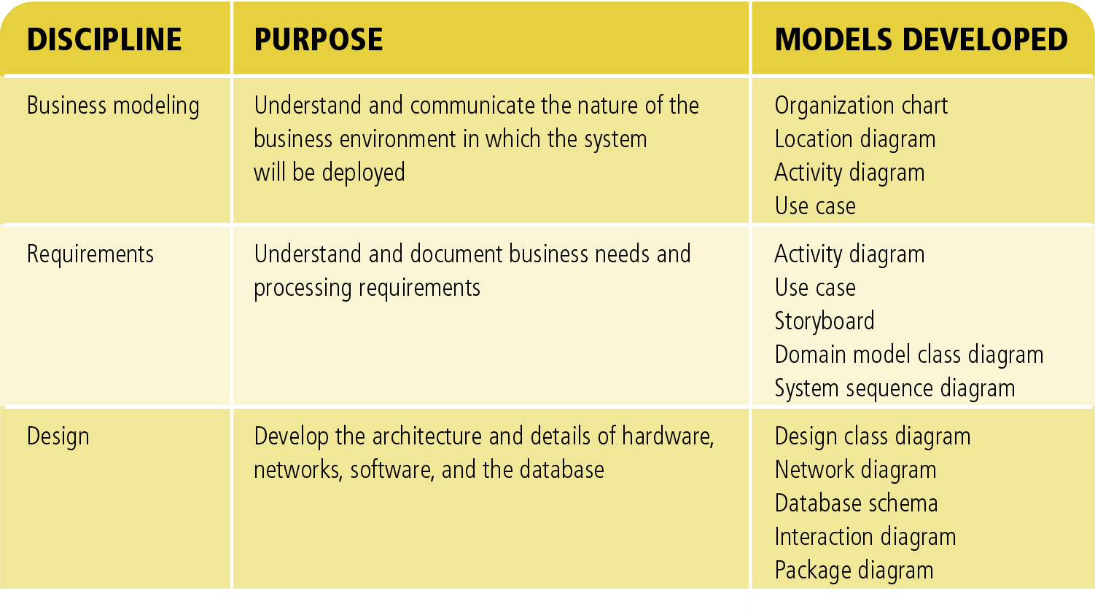
Figure 7-1
Comparison of Modeling During the Business Modeling,
Requirements, and Design Disciplines
Object-Oriented Analysis and Design with the Unified Process

Slide 7
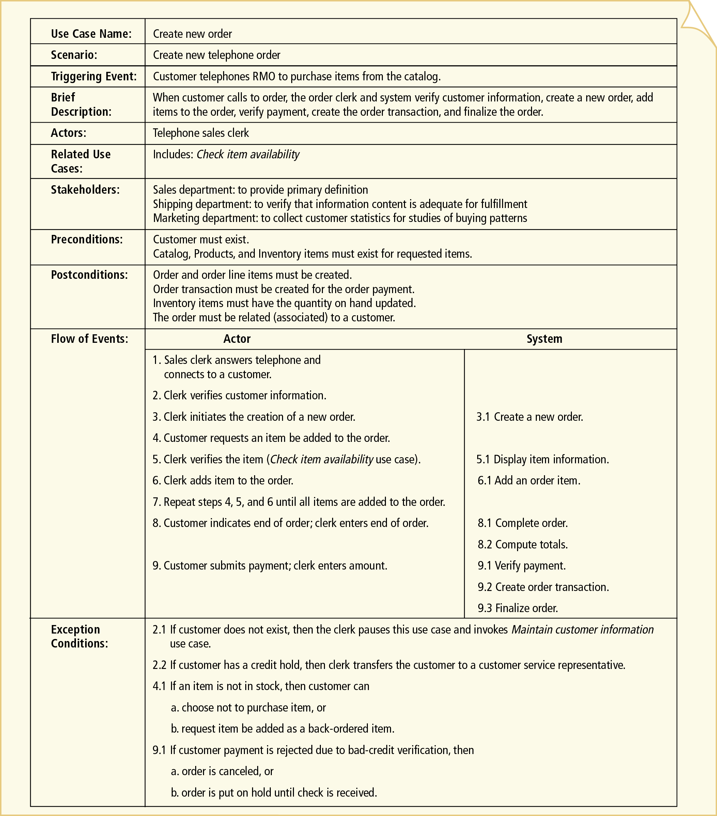
Use Case
Detailed
description
Object-Oriented Analysis and Design with the Unified Process

Slide 8
Understanding the Elements of Design
Systems design discipline
  Describe, organize, and structure system components
  Artifacts at architectural level and detailed level
  Purpose: enable system construction and deployment
Two tiers of discipline tasks
  High (architectural)
    Hardware, network, and system software infrastructure
  Low(detail design)
    Small modules such as software design for a use case
Object-Oriented Analysis and Design with the Unified Process

Slide 9
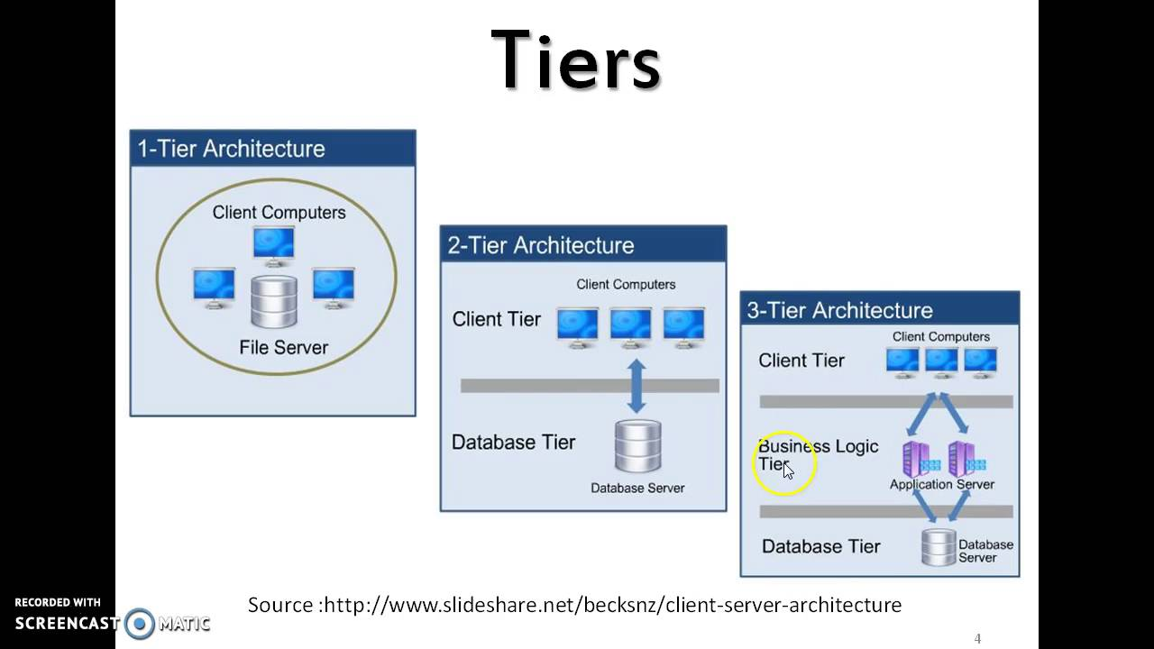
Object-Oriented Analysis and Design with the Unified Process

Slide 10
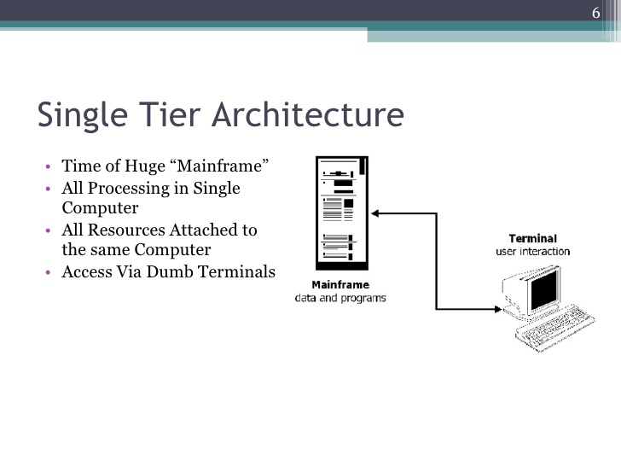
Object-Oriented Analysis and Design with the Unified Process

Slide 11
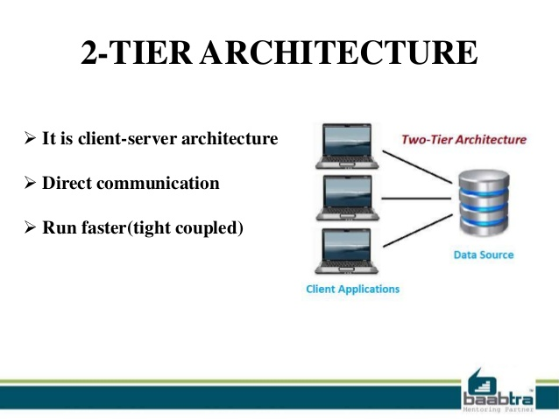
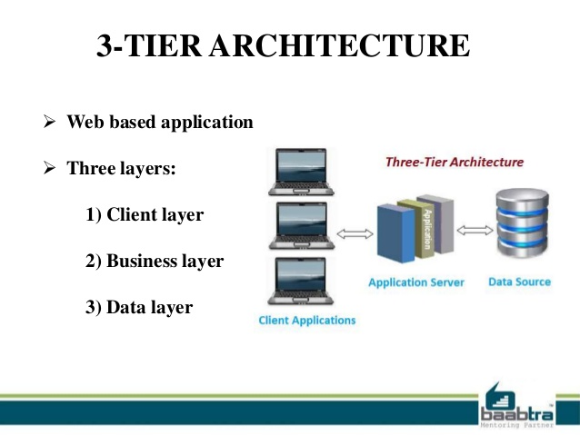
Object-Oriented Analysis and Design with the Unified Process

Slide 12
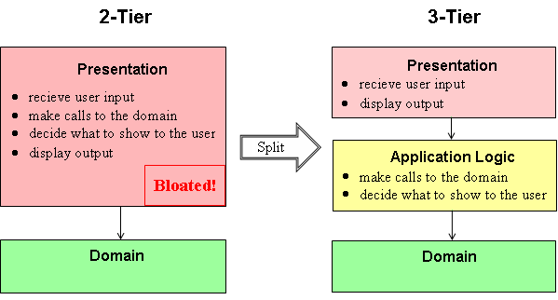
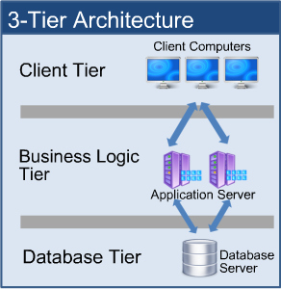
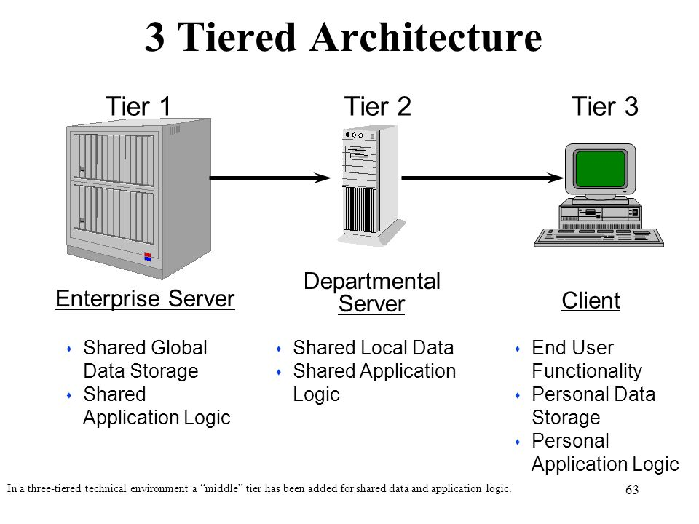
Object-Oriented Analysis and Design with the Unified Process

Slide 13
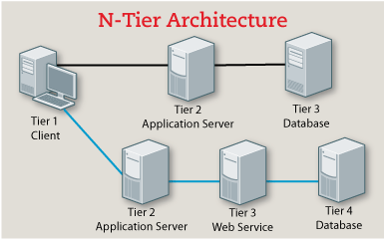
Object-Oriented Analysis and Design with the Unified Process

Slide 14
Design Discipline Activities
Segmented into six major activities
Higher-level activities contains and interacts with many lower-level activities
Object-Oriented Analysis and Design with the Unified Process

Slide 15
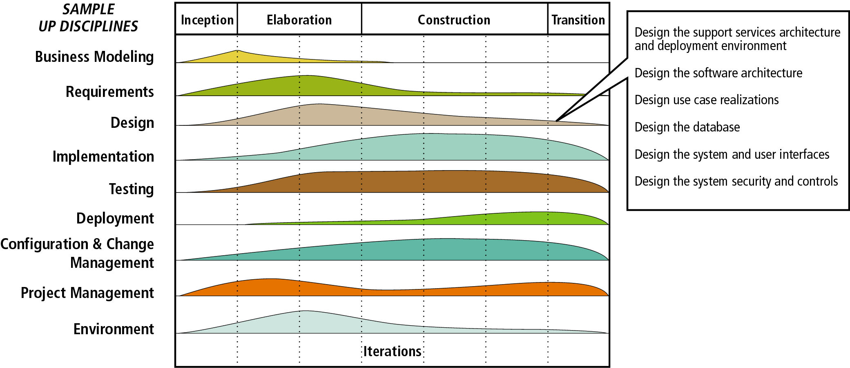
Figure 7-2
Design Activities in the UP Life Cycle
Object-Oriented Analysis and Design with the Unified Process

Slide 16
Design the Support Services Architecture and Deployment Environment
Three organizational dispositions to new systems
  Integrate new systems into existing systems
  Install support services for the first time
  Replace existing systems
Design issues for all organizations
  Reliability
  Security
  Throughput
  Synchronization
Object-Oriented Analysis and Design with the Unified Process

Slide 17
Design the Software Architecture
Software architecture refers to the “big picture”
Two important aspects
  Division of software into classes
  Distribution of classes across processing locations
Modify class diagrams into software classes
  Determine where classes and objects execute
  Determine whether they will be distributed
  Determine communication methods
  Select programming language(s) to write classes
Object-Oriented Analysis and Design with the Unified Process

Slide 18
Design Use Case Realizations
Use case realizations offer a lower-level view
Two-tiered focus
  Class interactions supporting a particular use case
  Interactions among software, users, and external systems
  Decide 1 tier, 2 tier or 3 tier application
Design typically spread over many iterations
UML design class diagrams and interaction diagrams document design
Object-Oriented Analysis and Design with the Unified Process

Slide 19
Design the Database
Designing database as a key design activity
Physical model of database based on class diagram
Physical model describes relational or OO database
Some technical issues
  Performance, such as response time
  Integration with existing databases
  Legacy databases
Object-Oriented Analysis and Design with the Unified Process

Slide 20
Design the System and User Interfaces
System interface issues
  Different types of systems will interface
  Systems interact with internal and external users
User interface issues
  User capabilities and needs differ widely
  User interacts with the system in different ways
  Approaches to interface vary by system
  Has nature of interface emerged from earlier models?
Object-Oriented Analysis and Design with the Unified Process

Slide 21
Design the System Security and Controls
User-interface controls limit access to authorized users
System interface controls protect system from other systems
Application controls record transactions and validate work
Database controls ensure data protected from unauthorized access and accidental loss
Network controls protect network communication
Object-Oriented Analysis and Design with the Unified Process

Slide 22
Design Activities and the UP
Focus in early iterations of elaboration phase
  System architecture and databases
Evenly distributed throughout project
  Detailed design activities
Criteria analyst uses to schedule design activities
  Experience
  Forecasting capabilities
Every design impacts other parts of system
Object-Oriented Analysis and Design with the Unified Process

Slide 23
Project Management ⎯ Coordinating the Project
Design activities require substantial coordination
Complicating factors
  Tracking multiple iterations in parallel
  Initiation of two other miniprojects
    Data conversion project
    Test case development project
  Initiation of construction activities (programming)
  Addition (or departure) of team members
  Distribution of workers over different locations
Object-Oriented Analysis and Design with the Unified Process

Slide 24
Coordinating Project Teams
Project schedule: tool that coordinates various activities
Scheduling duties
  Update the schedule
    Estimate durations for design and construction tasks
    Estimate duration of tasks associated with requirements
  Delegate scheduling duties to key teams
  Coordinate various scheduling efforts with status meetings
Object-Oriented Analysis and Design with the Unified Process

Slide 25
The Project Team at RMO
Memo from Barbara Halifax with highlights
  Team members have been added
  Two new subprojects initiated
    Database design and data conversion
    Infrastructure upgrades
Object-Oriented Analysis and Design with the Unified Process

Slide 26
Coordinating Information
Details of system needing capture:
  Classes, data fields, forms, reports, methods, tables
Two kinds of tools assisting information capture
  CASE tools
    Central repository stores information
  Computer support for collaborative work
    Lotus Notes
Object-Oriented Analysis and Design with the Unified Process

Slide 27
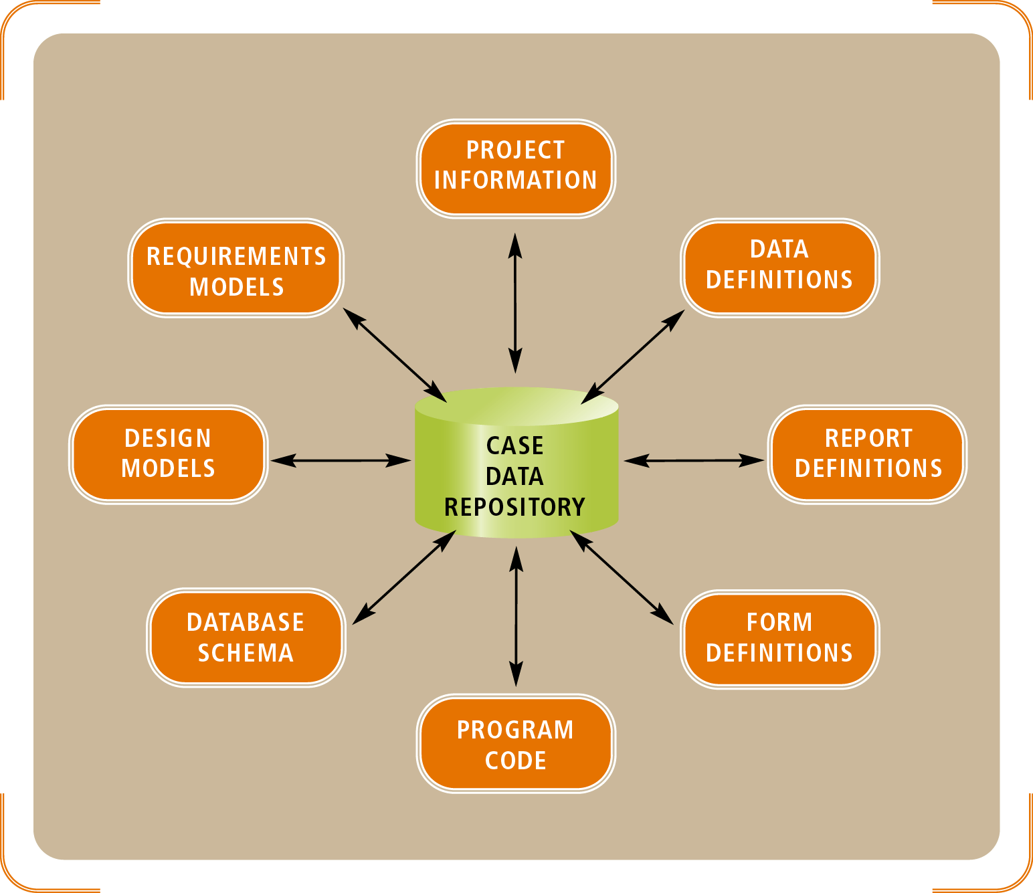
Figure 7-3
System Development Information Stored in the CASE Repository
Object-Oriented Analysis and Design with the Unified Process

Slide 28
Deployment Environment
System operational environment
  Hardware
  System software
  Networking environment
Object-Oriented Analysis and Design with the Unified Process

Slide 29
Single-Computer and Multitier Architecture
Single-computer architecture
  Single system attached to peripheral devices
  PC and mainframe applications qualify
  Advantages: easy to design, build, operate, maintain
  Disadvantages: capacity limits
Object-Oriented Analysis and Design with the Unified Process

Slide 30
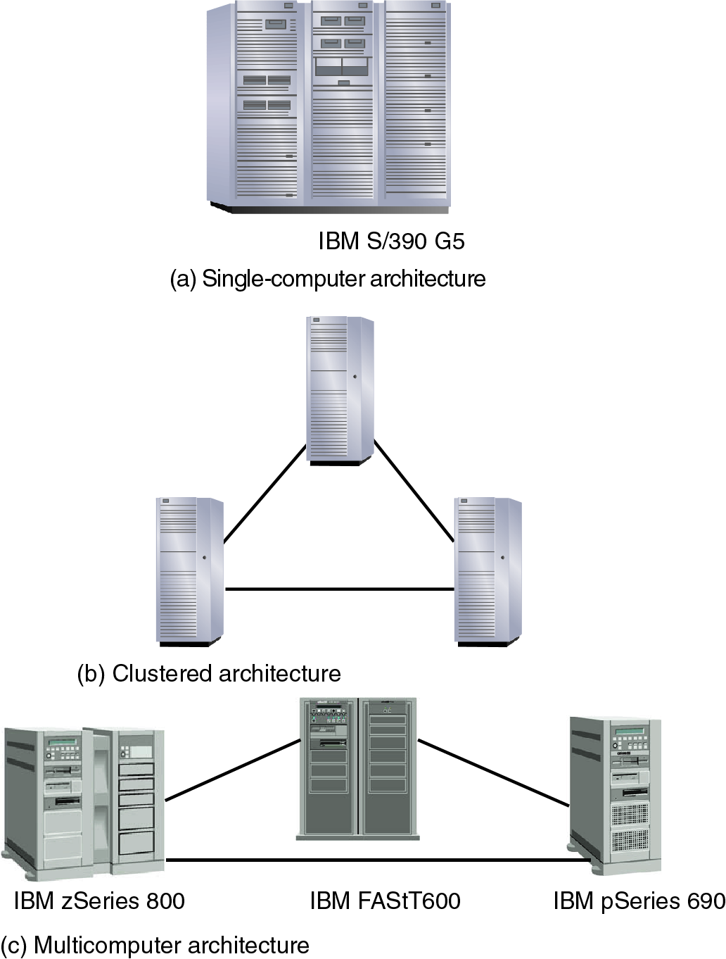
Figure 7-4
Single-computer, Clustered, and Multicomputer Architectures
Object-Oriented Analysis and Design with the Unified Process

Slide 31
Object-Oriented Analysis and Design with the Unified Process
Object-Oriented Analysis and Design with the Unified Process

Slide 32
Single-Computer and Multitier Architecture (continued)
Multitier architecture (multiple computer systems)
  Clustered architecture
    Group of computers logically operate as one
    Nodes from same manufacturer and model family
  Multicomputer architecture
    Cluster whose nodes are optimized or specialized
    Hardware and operating systems may be dissimilar
Object-Oriented Analysis and Design with the Unified Process

Slide 33
Centralized and Distributed Architecture
Centralized architecture
  Deploys computer systems in single location
  Used for large-scale processing applications
  Constraint: geography
  Implements subsystems in larger information system
Distributed architecture
  Software/data spread across systems and locations
  Relies on communication networks to interconnect
Object-Oriented Analysis and Design with the Unified Process

Slide 34
Computer Networks
LAN connects computers at each geographic location
LANs are members of WANs
Computer communication capabilities
  Direct communications: telephone service and video conferencing
  Message-based communications: e-mail
  Resource sharing: electronic documents, application programs, databases
Many ways to distribute information system resources
Object-Oriented Analysis and Design with the Unified Process

Slide 35
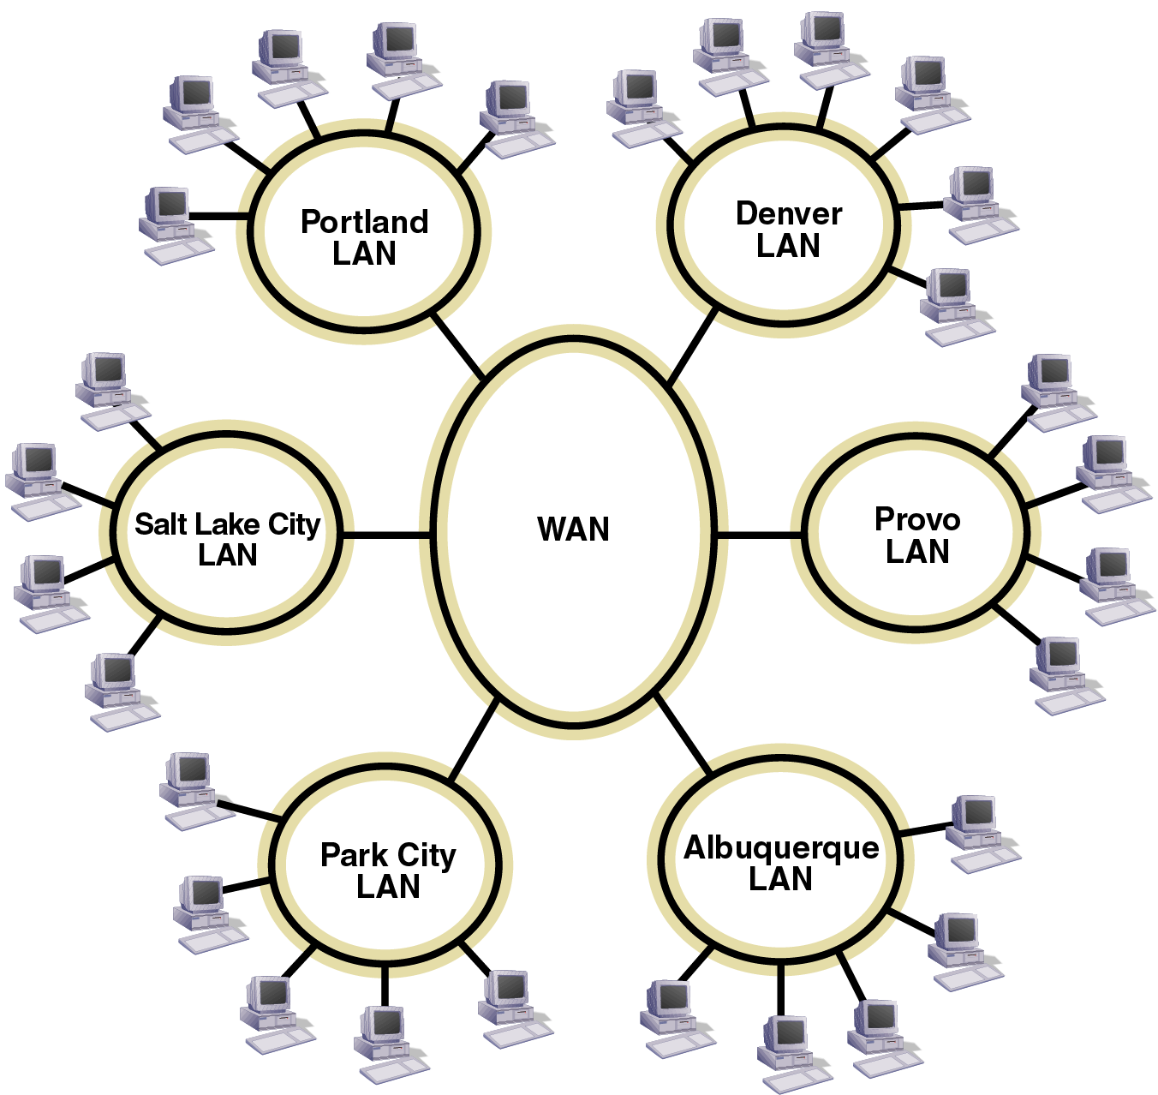
Figure 7-5
A Possible Network Configuration for RMO
Object-Oriented Analysis and Design with the Unified Process

Slide 36
The Internet, Intranets, and Extranets
Internet: global collection of networks
Networks connected using TCP/IP protocols
The World Wide Web (WWW), or the Web
  Collection of resources accessed over the Internet
Intranet: private network accessible to internal users
Extranet: intranet extended to include some external users
  Example: virtual private network (VPN)
Object-Oriented Analysis and Design with the Unified Process

Slide 37
The Environment at Rocky Mountain Outfitters
Deployment environment at RMO
  Manufacturing facilities
  Warehouses
  Retail stores
  Mail-order center
  Phone center
  Data center
Various locations data networked
Object-Oriented Analysis and Design with the Unified Process

Slide 38
The Current Environment
Park City mainframe is processing hub
Various subsystems have two access methods
  Dedicated links
  Dial-up links
Object-Oriented Analysis and Design with the Unified Process

Slide 39
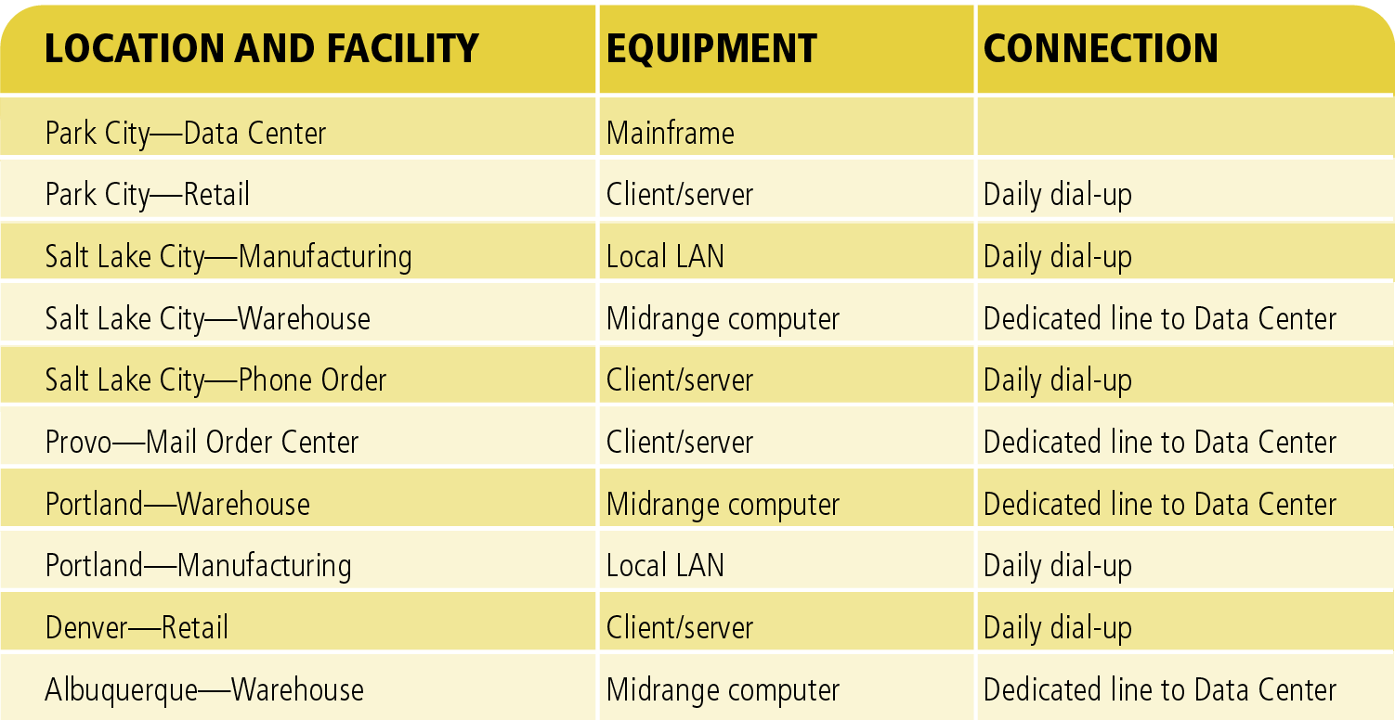
Figure 7-6
The Existing Processing Environment at RMO
Object-Oriented Analysis and Design with the Unified Process

Slide 40
The Proposed Environment
Issues for new customer support system (CSS)
  Integrate seamlessly with SCM (supply chain management system)
  Technical decisions should be consistent with long-term technology plan
RMO convened meeting to sort through alternatives
Alternatives listed by type of technology and degree of centralization
Object-Oriented Analysis and Design with the Unified Process

Slide 41
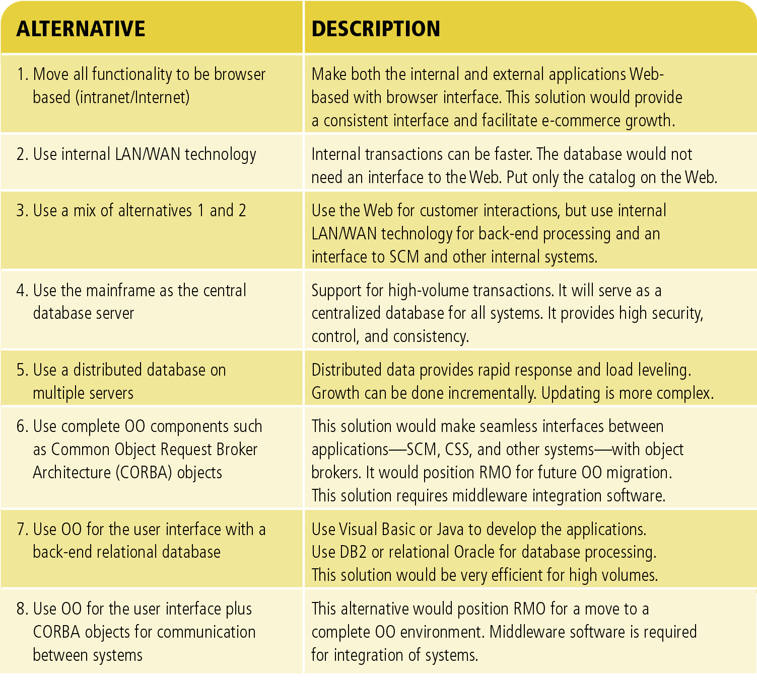
Figure 7-7
Processing Environment Alternatives
Object-Oriented Analysis and Design with the Unified Process

Slide 42
The Proposed Environment (continued)
Two conflicting goals
  RMO wants its system to be state of the art
  RMO also wants to avoid high-risk project
Compromise between old and new
Mainframe remains the central database server
Two new tiers will be application and Web servers
Desktops will access Web servers via a Web browser
Object-Oriented Analysis and Design with the Unified Process

Slide 43
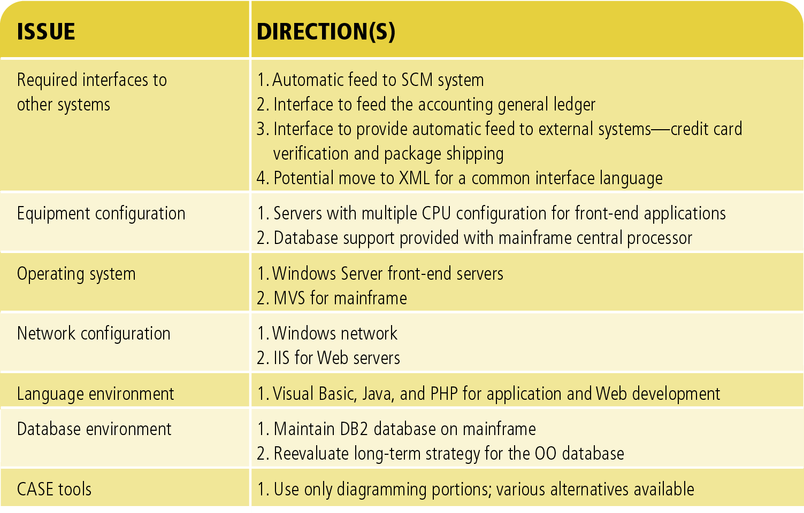
Figure 7-8
Strategic Directions for the Processing Environment at RMO
Object-Oriented Analysis and Design with the Unified Process

Slide 44
Client/Server Architecture
Client/server architecture tiers
  Client: requests resources or services from a server
  Server: manages information system resources
Architectural issues for client/server software:
  Decomposing software into client and server programs (objects)
  Determining where clients and servers will execute
  Describing interconnection protocols and networks
Object-Oriented Analysis and Design with the Unified Process

Slide 45
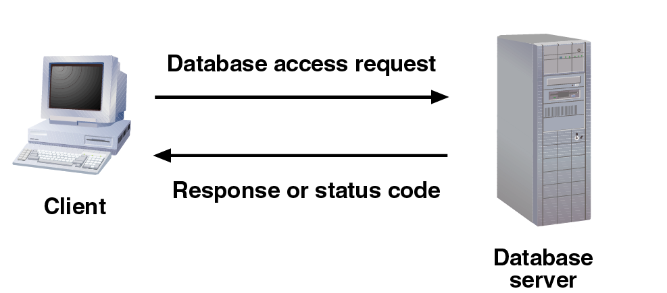
Figure 7-9
Client/Server Architecture with a Shared Database
Object-Oriented Analysis and Design with the Unified Process

Slide 46
Client/Server Architecture
(continued)
Client and server communicate via well-defined protocols over a physical network
Client/server architecture advantages
  Location flexibility, scalability, maintainability
Client/server architecture disadvantages
  Additional complexity, potential poor performance, security issues, and reliability
Object-Oriented Analysis and Design with the Unified Process

Slide 47
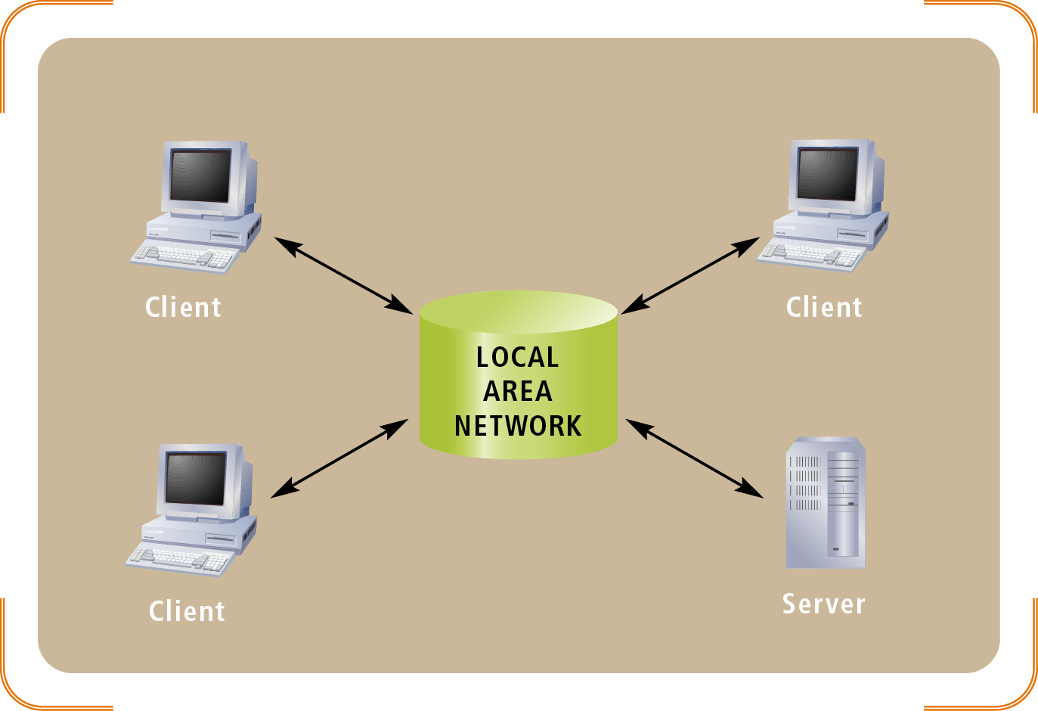
Figure 7-11
Interaction Among Multiple Clients and a Single Server
Object-Oriented Analysis and Design with the Unified Process

Slide 48
Three-Layer Client/Server Architecture
Variant of client/server architecture
  Divides application software into independent processes
Three-layers
  The data layer
  The business logic layer
  The view (presentation) layer
Three-tier architecture advantages
  Additional flexibility and reliability
Object-Oriented Analysis and Design with the Unified Process

Slide 49
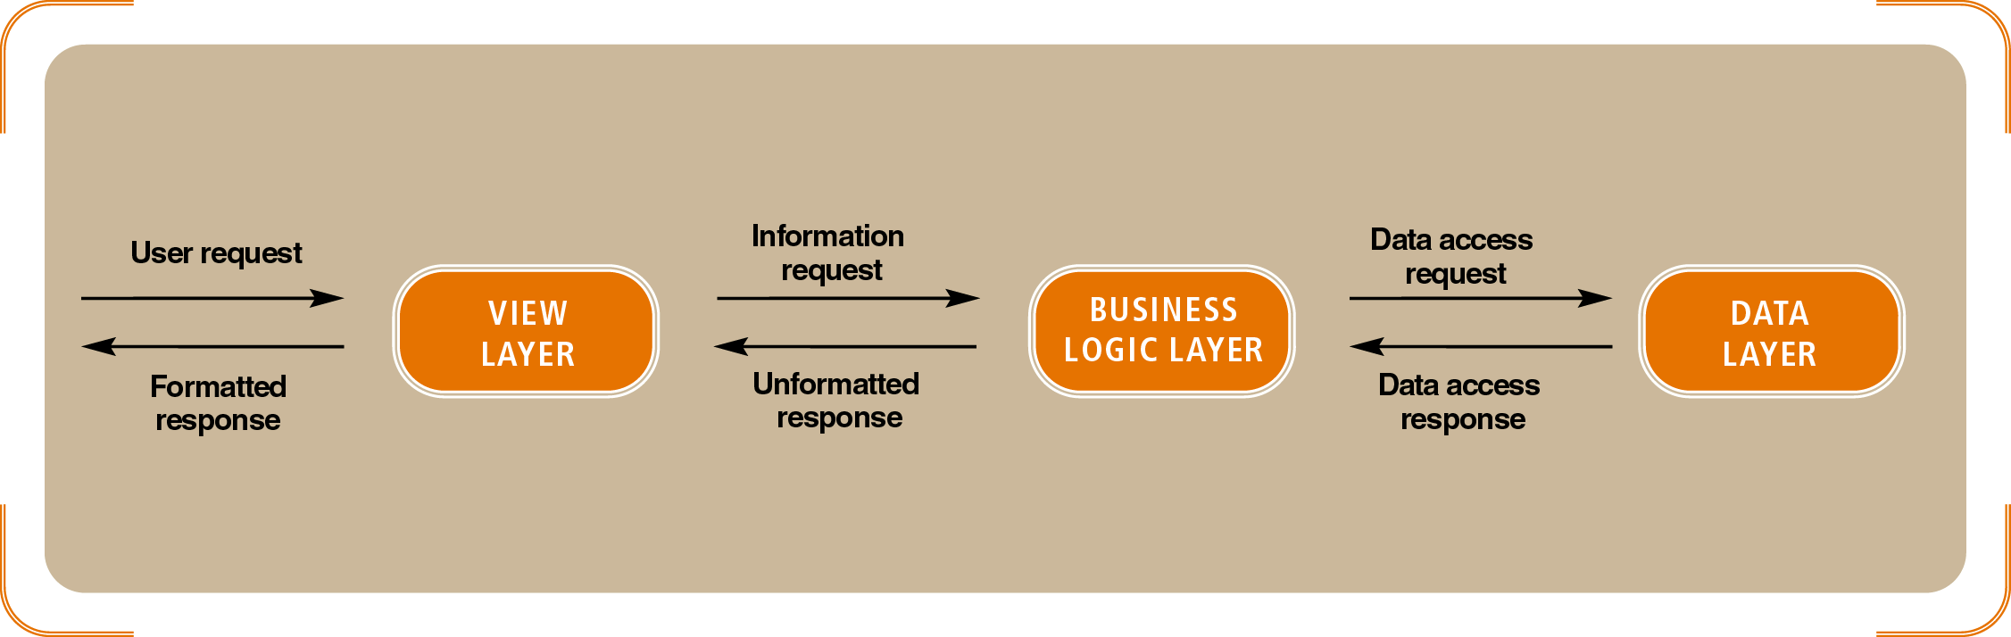
Figure 7-12
Three-layer Architecture
Object-Oriented Analysis and Design with the Unified Process

Slide 50
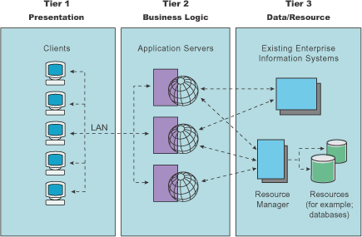
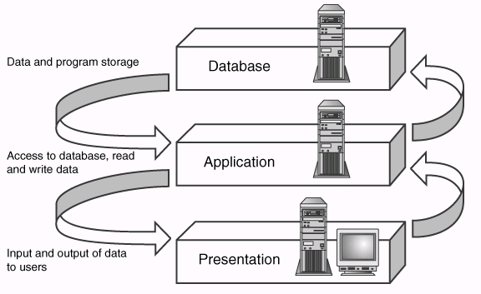
Object-Oriented Analysis and Design with the Unified Process

Slide 51
Middleware
Middleware
  Connects parts of an application
  Enables requests and data to pass among them
Common types of middleware
  Teleprocessing monitors
  Transaction processing monitors
  Object request brokers (ORBs)
Each type of middleware has its own set of protocols
Object-Oriented Analysis and Design with the Unified Process

Slide 52
Internet and Web-Based Software Architecture
Web is complex example of client/server architecture
  Web resources are managed by server processes
  Clients are programs that send requests to servers
  Web protocols define valid resource formats and communication standards
  Web-like capabilities embedded in ordinary applications
Web-oriented client/server architecture: service-oriented architecture (SOA)
Object-Oriented Analysis and Design with the Unified Process

Slide 53
Internet and Web-Based Software Architecture (continued)
Flexibility is the key to the Internet alternative
  Accessibility, low cost communication, widely used standards
Disadvantages of Web technologies
  Security, reliability, throughput, and volatile standards
The key architectural design issues
  Defining client and server processes or objects
  Distributing processes across hardware platforms
  Connecting processes
Object-Oriented Analysis and Design with the Unified Process

Slide 54
Network Design
The key network design issues
  Integrating new network needs within existing infrastructure
  Describing local processing activity and network connectivity
  Describing the communication protocols and middleware
  Ensuring that sufficient network capacity is available
Object-Oriented Analysis and Design with the Unified Process

Slide 55
Network Integration
Factors impacting network integration
  Connections for new servers
  Modifying routing and firewall configuration
  Expansion of capacity
  New communication protocols
  Modified security protocols
Analyst may share or delegate tasks to the network administrator
Object-Oriented Analysis and Design with the Unified Process

Slide 56
Network Description
Location documents expanded to include
  Processing locations
  Communication protocols
  Middleware
  Communication capacity
Many different ways to describe network infrastructure
Object-Oriented Analysis and Design with the Unified Process

Slide 57
Communication Protocols and Middleware
Network diagram: source of protocol and middleware requirements
Park City data center LAN requirements
  Support at least one protocol for database queries and responses
Object-Oriented Analysis and Design with the Unified Process

Slide 58
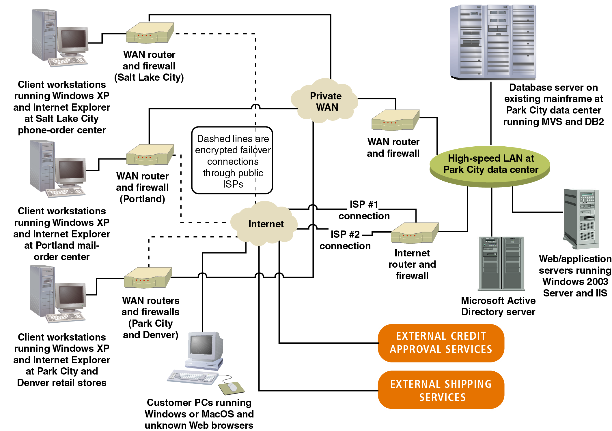
Figure 7-13
A Network Diagram for the RMO Customer Support System
Object-Oriented Analysis and Design with the Unified Process

Slide 59
Network Capacity
Sources for estimation: use case–location and use case–problem domain class matrices
Construct tables combining use case, class, and location
Actual data transmission capacity also includes communication protocol
Object-Oriented Analysis and Design with the Unified Process

Slide 60
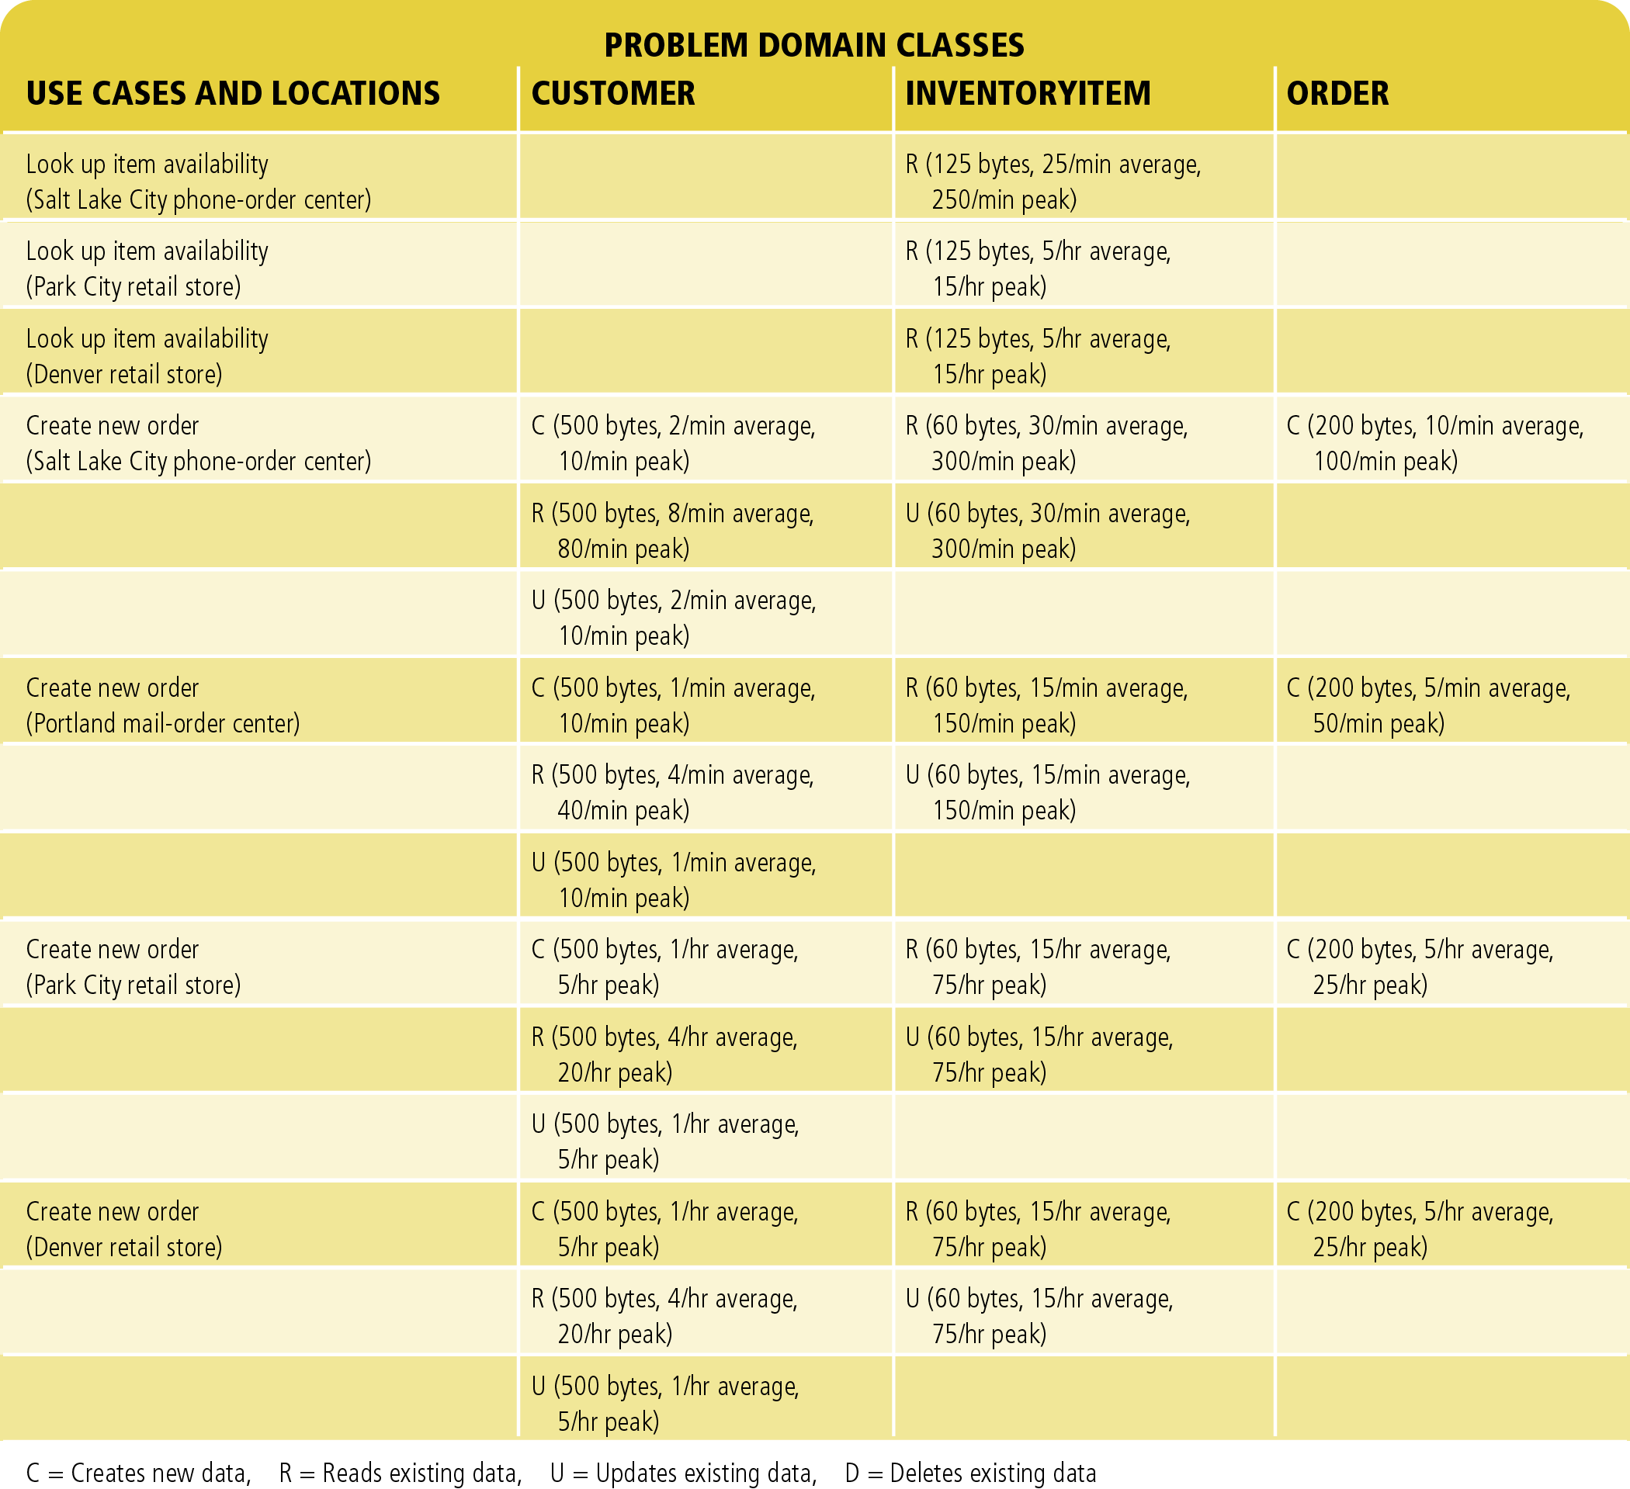
Figure 7-14
A Partial Use Case–problem Domain Class Matrix for RMO Customer Support System, Updated With Data Access Size and Volume Network Diagram for the RMO Customer Support System
Object-Oriented Analysis and Design with the Unified Process

Slide 61
Summary
Inputs to design phase: business and requirements models
Outputs of design phase: models describing system architecture
Project managers coordinate design activities
Technical staff make contributions in design phase
Division of high-level design activities: architectural and detail design
Object-Oriented Analysis and Design with the Unified Process

Slide 62
Summary (continued)
Architectural design adapts application to environment
Deployment environment: hardware, software, networks
Network organization: client/server or three-tier
Design decisions concern application layers, distributed software, specification of required protocols, middleware, and networks
Architectural design decisions documented in a network diagram
Object-Oriented Analysis and Design with the Unified Process

